Slide 1


PASS Insights
August, 2019
5 minutes
Hiram Fleitas
Fleitas Arts
github.com/hfleitas/rig
Notes:
Image ref: https://talesofarcadia.fandom.com/wiki/Toby_Domzalski

Slide 2
Copy to Azure SQL
From On-Prem with Azure Data Factory
Azure Data Factory
SQL Server
Azure SQL Data Warehouse
Azure SQL Hyperscale
Hiram Fleitas
Fleitas Arts
github.com/hfleitas/rig
Notes:
Image ref: https://talesofarcadia.fandom.com/wiki/Toby_Domzalski

Slide 3
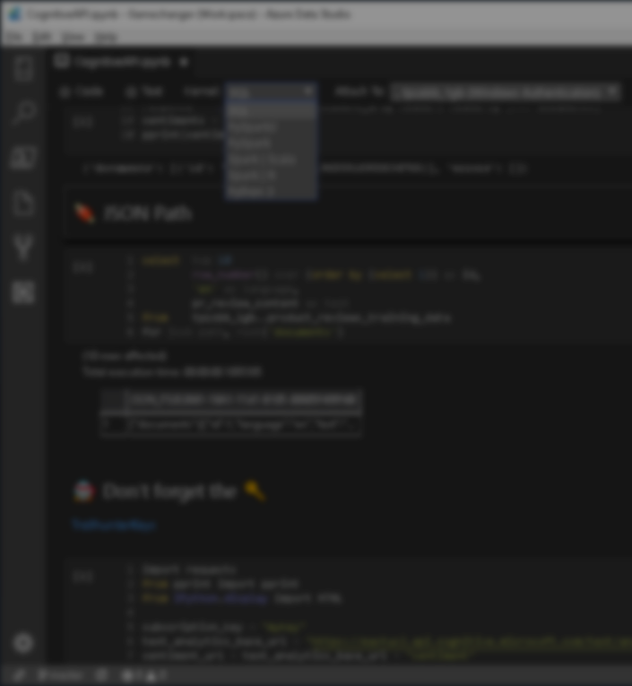

Session evaluations
This is the link:
bit.ly/ADF19
Your feedback is very important.
Submit your feedback by the end of this presentation.

Slide 4











Hiram Fleitas
Owner Fleitas Arts
Bio
Father
Principal DB Architect
SSIS since 2009
Developer since 1995
SQL Server since 1999
USCG Auxiliary Flotilla Staff Officer
@hiramfleitas
/hfleitas
hiram@fleitasarts.com
hiramfletias
fleitasarts.com

Slide 5
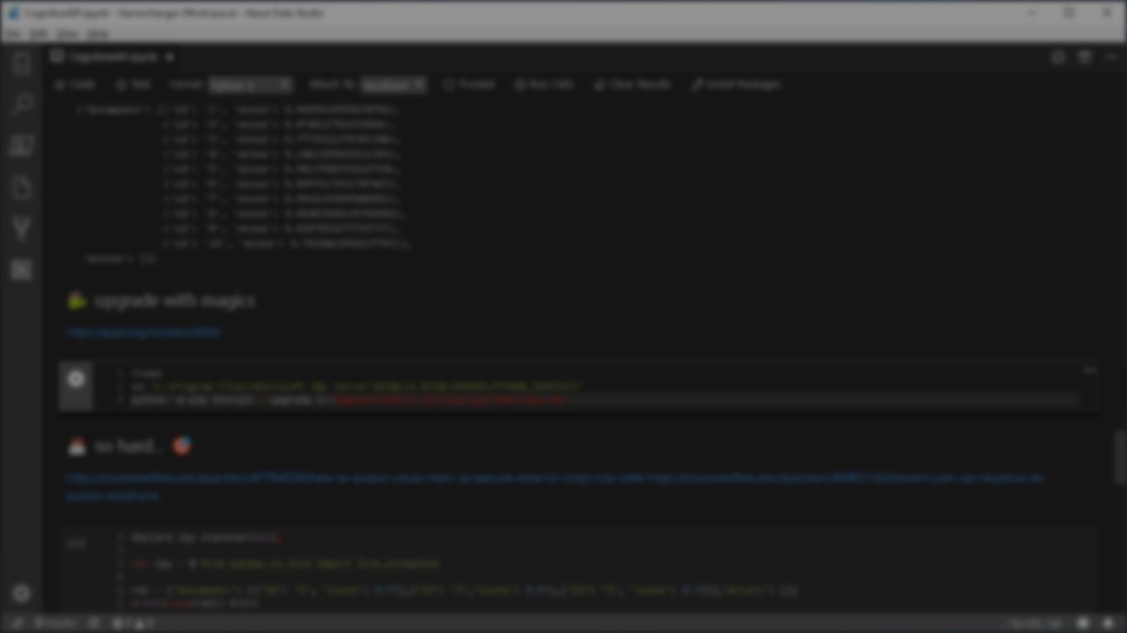


Agenda
Azure Data Factory
Pipeline Parameters
Automate Azure SQL Data Warehouse
Create Schemas using Azure Data Studio
Copy Activity
Connectors
Integration Runtime
Staging, Polybase External Table & CTAS
Append / Bulk Insert, Merge
Resources

Slide 6
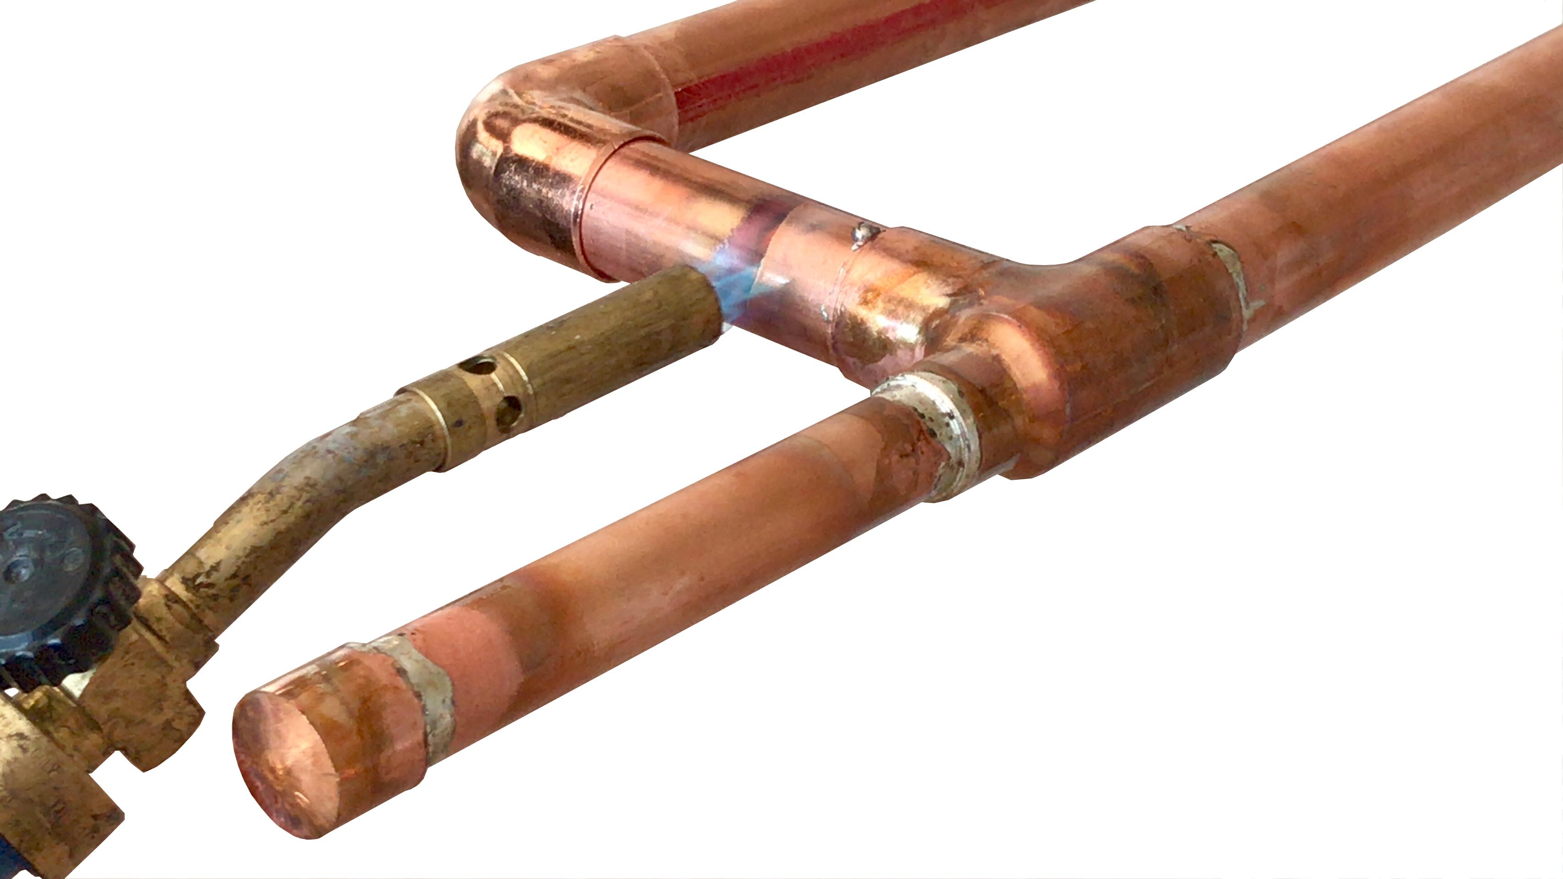
DEMO
Azure Data Factory

Slide 7
Summary
Azure Data Factory
Pipeline Parameters
Automate Azure SQL Data Warehouse
Create Schemas using Azure Data Studio
Copy Activity
Connectors
Integration Runtime
Staging, Polybase External Table & CTAS
Append / Bulk Insert, Merge
Resources

Slide 8
Resources
http://fleitasarts.com
github.com/hfleitas/rig
netflix.com/trollhunters
Data Factory: Documentation
Data Factory: Copy Activity Performance
Data Factory: Connector Azure SQL Data Warehouse
Connector SQL Server: Append Data
Azure SQL DW: HASH vs Round-Robin Distributed Tables
Azure Friday: Managed Service Identity
aka.ms/azuremsi
Greg Galloway: github.com/furmangg
pass.org/summit
Notes:
Image ref: https://talesofarcadia.fandom.com/wiki/Toby_Domzalski

Slide 9
Session evaluations
This is the link:
bit.ly/ADF19
Your feedback is very important.
Submit your feedback by the end of this presentation.

Slide 10
Hiram Fleitas
Owner Fleitas Arts
@hiramfleitas
Thank You
hiram@fleitasarts.com
fleitasarts.com
/hfleitas
hiramfleitas

